Slide 1


SMART INDIA HACKATHON 2025
TITLE PAGE
ArgoSmart: Smart Irrigation with Rainwater Harvesting
Problem Statement ID - SIH25062
Problem Statement Title - Implementation of Smart Agriculture for Efficient Cultivation in Hilly Regions
Theme - Agriculture, FoodTech & Rural Development
PS Category - Hardware
Team Name - Team Titans

Slide 2
IDEA TITLE
Team Titans
ArgoSmart: Smart Irrigation with Rainwater Harvesting
PROBLEM:
Rainless summers and frequent water scarcity: This makes traditional irrigation unreliable and inefficient.
Difficulty providing adequate water to crops: This leads to reduced yields and waste. resources.
Climate change: This is intensifying the existing issues of water scarcity.
SOLUTION:
Soil moisture sensors to monitor field conditions by using Soil moisture sensor.
Temperature sensors to monitor field conditions by using Temperature Sensor(DTF11).
Automated valve control through microcontrollers (Arduino).

Slide 3
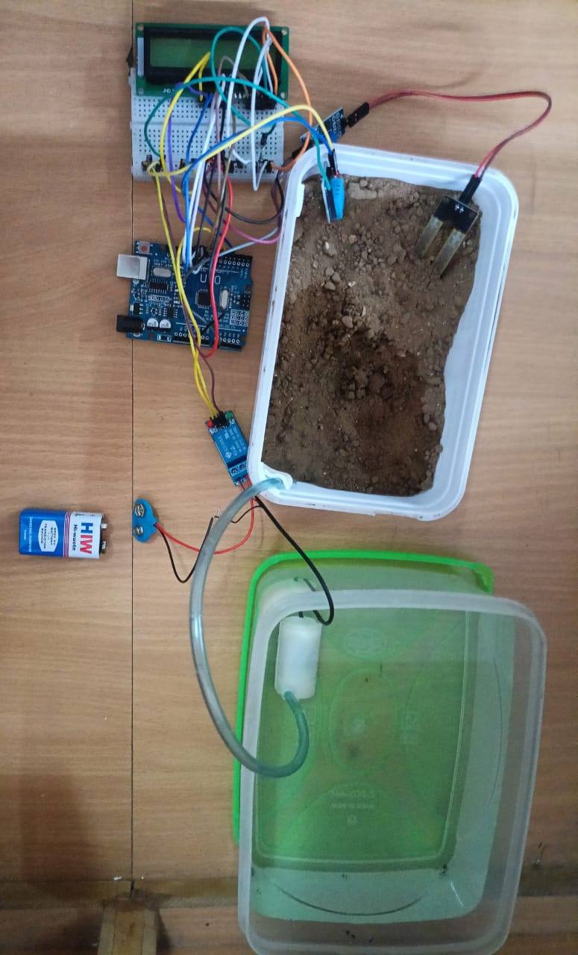
TECHNICAL APPROACH
Team Titans
USED TECHNOLOGY:
Hardware:
Sensors
Soil Moisture Sensors
Temperature Sensors
Microcontrollers
Arduino
Actuators
Automated Valves
Water Pumps

Slide 4
FEASIBILITY AND VIABILITY
Team Titans
Feasibility
Technology Readiness – IoT backbone using ESP32/Arduino with soil-moisture, temperature, humidity, and water-level sensors ensures accurate real-time monitoring and reliable pump control.
Integration – Easily integrates with existing irrigation lines and rainwater storage tanks without major redesign of current water distribution systems.
Performance – Automated sensing and motor ON/OFF operation maintains optimal soil moisture, reducing water wastage and improving plant health.
Scalability – System can scale from a single garden or farm plot to multiple fields by adding extra sensors, pumps, and wireless nodes.
Viability
Economic Viability – Saves significant mains-water costs and reduces manual labor through automatic irrigation scheduling.
Practical Benefits – Suitable for household gardens, community farms, and remote agricultural areas where water scarcity or irregular supply exists.
Social Viability – Promotes sustainable water usage and supports food security by maintaining consistent crop yields even during dry periods.
Environmental Sustainability – Captures and reuses rainwater, lowering groundwater extraction and conserving natural resources.

Slide 5
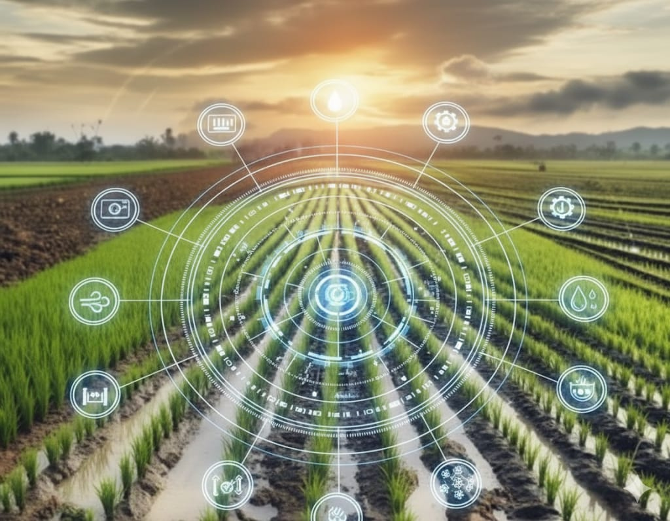
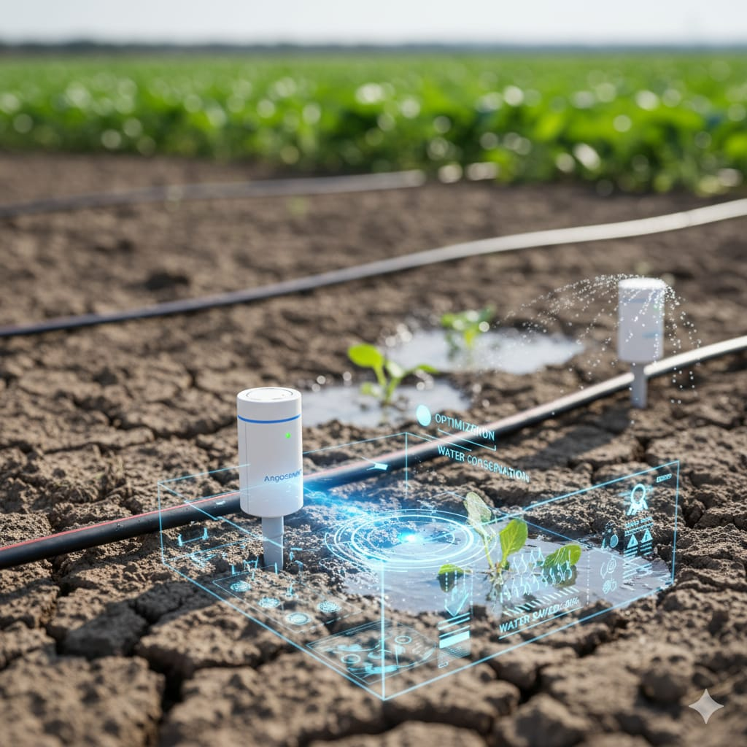
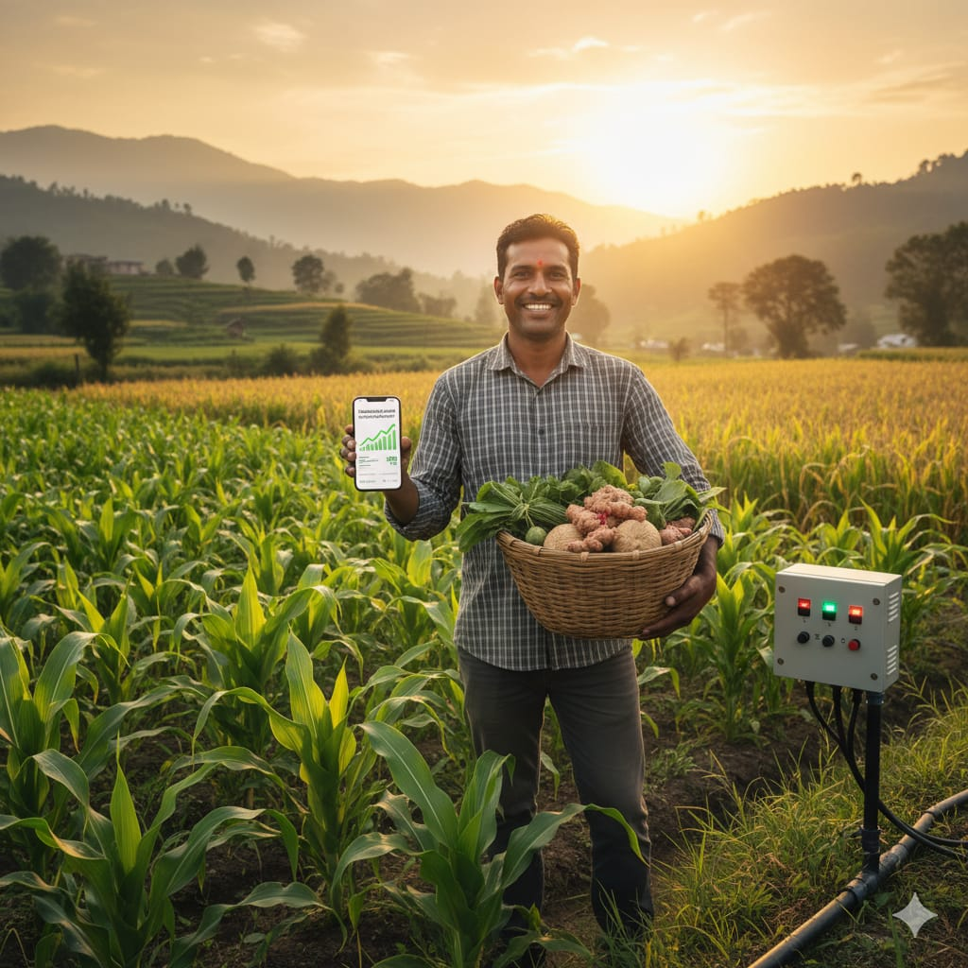


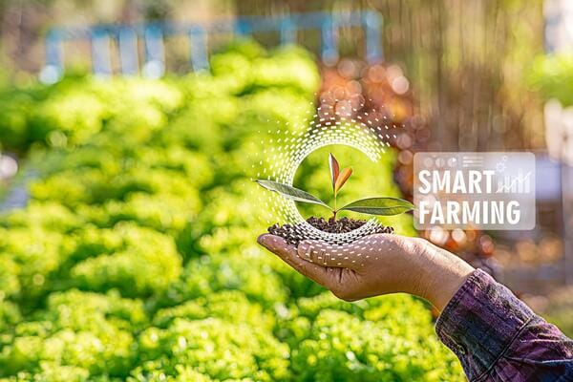
IMPACT AND BENEFITS
Team Titans
IMPACT
BENEFITS
Environmental Sustainability
Enhanced Water Conservation
1
1
Economic Empowerment
Climate Change Adaptation
2
2
Community &Regional Development
Increased Crop Yields & Quality
3
3

Slide 6
RESEARCH AND REFERENCES
Team Titans
Books
“Rainwater Harvesting for Drylands and Beyond, Volume 1 & 2” – Brad Lancaster (Chelsea Green Publishing)
“Internet of Things (IoT) for Sustainable Agriculture” – edited by Raj P. & S. Shanmugam
Websites
The Rainwater Harvesting Community (HarvestH2O)
Central Ground Water Board – Rainwater Harvesting Guide

